Slide 1

Design & Frontend Development
An introduction to what designers & front end developers do

Slide 2
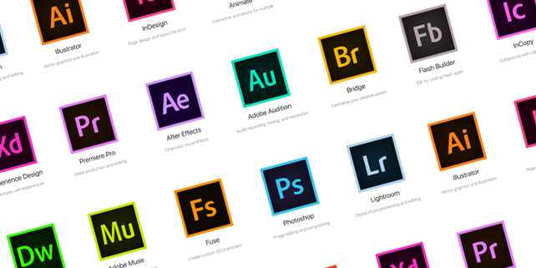
What is a web designer & frontend developer
A web designer is someone who is both creative and technically minded, and uses both these abilities to build or redesign websites. A web designer has the ability to understand what is needed to make a website functional, easy to use and aesthetically pleasing to the user.
So what’s the difference between designers and Programmers?

Slide 3
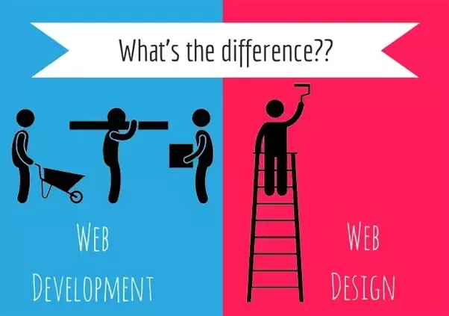

Slide 4

HTML
HTML, stands for hypertext markup language, is simply a set of tags we use to describe to the browser how our webpages are structured. We do this by surrounding the content of our webpages with these HTML tags.
The best way to look at this is to think coding a web page is making a blueprint for the browser.

Slide 5

HTML example
<!DOCTYPE html> <html> <head> <title>Page Title</title> </head> <body> <h1>This is a Heading</h1> <p>This is a paragraph.</p> </body> </html>
What you're saying here is hey browser, I want this particular section of my website to be a paragraph.
HTML tags label pieces of content such as “Section” “heading”, “paragraph”, “table”, and so on
A great resource for finding out what these are and how they should be used is:
w3schools.com

Slide 6
Structure of a HTML page
<html>
<head>
<body>

Slide 7
Structure of a HTML page continued…
The outer most box is HTML, and that contains all the information about your webpage. Inside the HTML box are two more boxes, head and body.
The head contains a lot of behind the scenes information that people won't see. But that's important for the browser to display your page properly.
The body box contains everything you see in the browser. Inside the body is where you have a lot of freedom. Where you can add as many or as few boxes, as you'd like, these are usually <div> tags.

Slide 8
HTML tags
There are around 120 HTML tags available to use some of these have been depreciated since the introduction of HTML5.
The majority of these you will never use.
You can see the full list of tags on w3Schools here
You could easily build a fairly complex web site or application using around 16 tags and some clever CSS
So what are these tags and what can they be used for?

Slide 9
Common tags we use to build websites
<div>
<div>
The <div> tag defines a division or a section in an HTML document.
The <div> tag is used to group block-elements to format them with CSS.
The <div> tag is used together with CSS, to layout a web page.
Example
<div> <h3>This is a heading</h3> <p>This is a paragraph.</p> </div>
CSS Selector
div { CSS Properties go here }

Slide 10
<h1>
<h1> - <h6>
The <h1> to <h6> tags are used to define HTML headings.
<h1> defines the most important heading. <h6> defines the least important heading.
Example
<h1>This is heading 1</h1> <h2>This is heading 2</h2> <h3>This is heading 3</h3> <h4>This is heading 4</h4> <h5>This is heading 5</h5> <h6>This is heading 6</h6>
CSS Selector
h1 { CSS Properties go here } h2 { CSS Properties go here } h3 { CSS Properties go here } h4 { CSS Properties go here } h5 { CSS Properties go here } h6 { CSS Properties go here }

Slide 11
<img>
The <img> tag defines an image in an HTML page.
The <img> tag has two required attributes: src and alt.
Example
<img src=“some-image.jpg” alt=“This is a image”/>
CSS Selector
Img { CSS Properties go here }
<img>

Slide 12
<p>
The <p> tag defines a paragraph.
Example
<p>This is some text in a paragraph.</p>
CSS Selector
P { CSS Properties go here }
<p>

Slide 13
<ul>
The <ul> tag defines an unordered (bulleted) list.
Use the <ul> tag together with the <li> tag to create unordered lists.
Example
<ul> <li>Coffee</li> <li>Tea</li> <li>Milk</li> </ul>
CSS Selector
ul { CSS Properties go here }
<ul>

Slide 14
<li>
The <li> tag defines a list item.
The <li> tag is used in ordered lists(<ol>), unordered lists (<ul>)
Example
<ul> <li>Coffee</li> <li>Tea</li> <li>Milk</li> </ul>
CSS Selector
li { CSS Properties go here }
<li>

Slide 15
<a>
The <a> tag defines a hyperlink, which is used to link from one page to another.
The most important attribute of the <a> element is the href attribute, which indicates the link's destination.
Example
<a href="https://www.realbuzz.com">Visit Realbuzz.com!</a>
CSS Selector
a { CSS Properties go here }
<a>

Slide 16
Other commonly used tags are:
<ol> - The <ol> tag defines an ordered list
<span> - The <span> tag is used to group inline-elements in a document.
<strong> - The <strong> tag is a phrase tag. It defines important text.
<table> & associated table tags - The <table> tag defines an HTML table.
You can learn more and see the full list of tags on w3Schools here
So what can we create using just HTML?

Slide 17
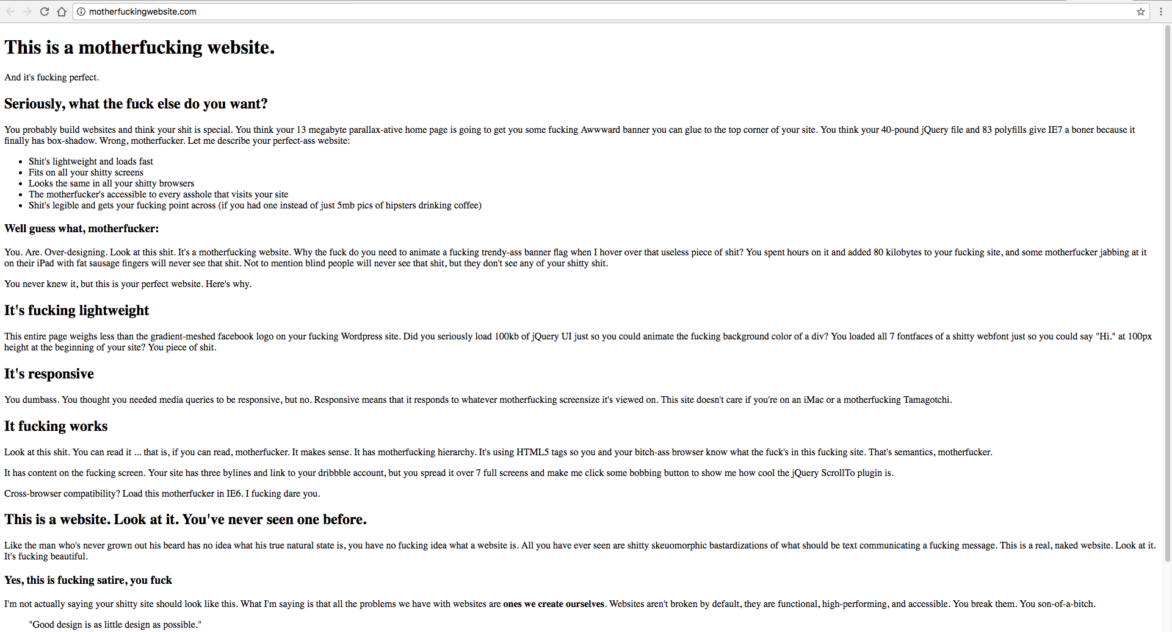
Heading tag <h1>
Paragraph tag <p>
Heading tag <h2>
Unordered list tag <ul> & list items <li> tags
Heading tag <h3>
To see an example of what can be done by just applying CSS to this page see: https://codepen.io/dredmorbius/pen/KpMqqB

Slide 18

Looking at a design
We are going to take a look at the design we are going to build together during this session the design provided is an example of what you could receive as a frontend developer for a page banner

Slide 19


Slide 20
Let’s break it down in to blocks
Look at the design and break it in to defined blocks these will become the HTML tags when we start building this example is fairly simple but the same principles can be applied to more complex designs.

Slide 21


Slide 22
Lets Write some HTML
We are going to be using codepen.io to create examples and learn how to code using HTML and CSS, you should have already signed up, if you have not then sign up now and start a new pen.

Slide 23
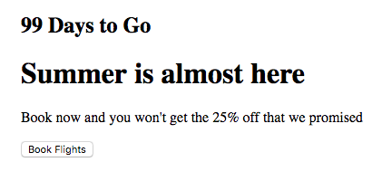
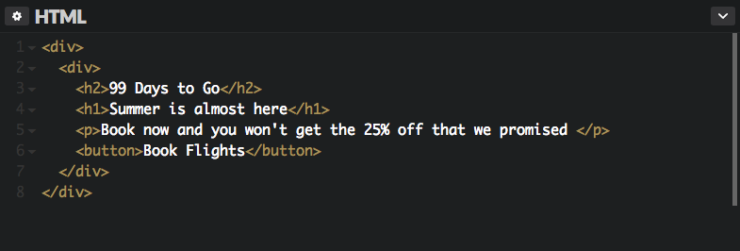
Create the following using HTML
You should only need to write 8 lines of html and use 6 tags to create the rendered view above ensure that you wrap the whole thing in a <div> tag, give this a go. If you are unsure of the syntax Google it or ask?

Slide 24
CSS
CSS stands for Cascading Style Sheet and is used by web pages to help keep information in the proper display format. CSS files can help define font, size, color, spacing, border and location of HTML information on a web page, and can also be used to create a continuous look throughout multiple pages of a website.
The main purpose of CSS is to allow users greater control over the presentation of a webpage without touching the structure.

Slide 25

CSS example
body { background-color: lightblue; } h1 { color: white; text-align: center; } p { font-family: verdana; font-size: 20px; }
What you're saying here is hey browser, I want the background of the page to be light blue, headings to be
white and aligned to the center, paragraphs to use the font verdana and be 20px.
A great resource for finding out what properties are available and how they should be used is:
w3schools.com

Slide 26
CSS properties
There are around 180 CSS properties available to use some of these have been depreciated since the introduction of CSS3.
You can see the full list of properties on w3Schools here
So I’m not going to go through these as you will use so many of them in development and there is not really a core set.

Slide 27
CSS selectors
In CSS, selectors are patterns used to select the element(s) you want to style, in general we either use a class or an ID these are defined on the HTML element you want to style.
Example:
For a class use a (.) .heading_tag { color: white; text-align: center; }
For a ID use a (#) #paragraph_tag { font-family: verdana; font-size: 20px; }

Slide 28
Lets Write some CSS
We are going to be using the HTML we created earlier in codepen.io Now I’m going to tell you what properties I used to create the example banner but I’m not going to tell you how and where I used them straight away have a go and see if you can work it out for yourself. If you have any questions just ask?
Hint: You will need to add a class to the div tags

Slide 29
CSS properties used
- display
- align-items
- height
- background
- background-size
- margin-left
- width
- margin-bottom
- font-size
- color
- font-family
- text-transform
- height
- line-height
- padding
- border
- border-radius
Hint: You will need to add a class to the div tags
Hint: I managed to do this in under 50 lines of CSS
Hint: Fork from the blank pen I have provided as all of the
fonts are already included and reset has been applied
Hint: There is more than one way to complete this task

